Slide 1
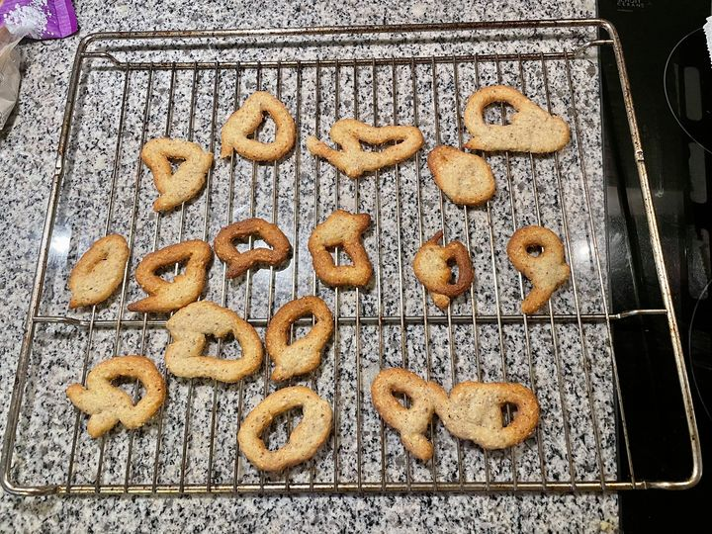
Lab intro
06

Slide 2
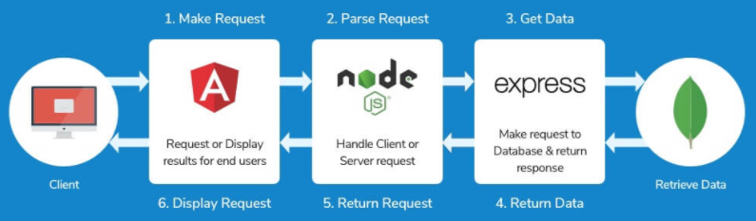
As-is
Conference site solution
Fabrikam Medical Conferences provides conference web site services tailored to the medical community. They handle over 100 conferences per year and growing.
The conference sites are typically low budget websites for conferences usually between 100 and 1500 attendees.
Today the sites are hosted on-premise.
The conference web sites are built with the MEAN stack (Mongo, Express, Angular, Node.js).
Notes:
Angular.js: client-side JavaScript framework
Node.js: JavaScript web server
Express.js: web framework for Node.js
MongoDB: NoSQL document DB

Slide 3
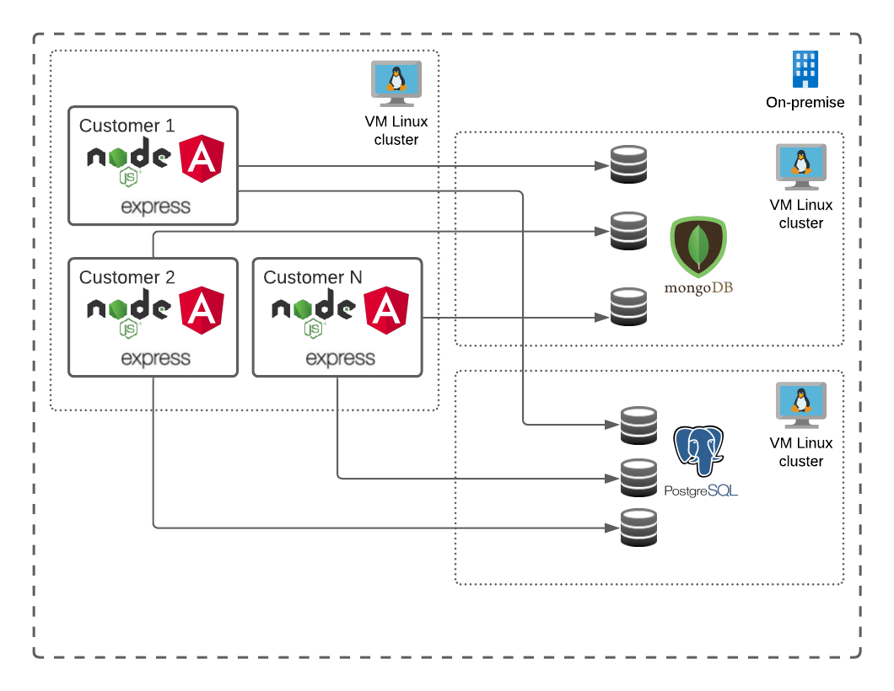
As-is
Current architecture

Slide 4
To-be
Customer business objectives
Lower costs
Improve customer satisfaction
Expand: Global reach and larger conferences
Be ready for the future

Slide 5
To-be
Customer technical objectives
Improve code base
Reduce dependencies between features
Reduce regressions introduced when changes are made
Improve scalability and reliability
Improve DevOps lifecycle
Better system health monitoring
Easy migration of data
Ready for future enhancements
Attendee session feedback with AI to prevent inappropriate content from being posted
Real-time language translation to better accommodate growing worldwide conference attendance.

Slide 6
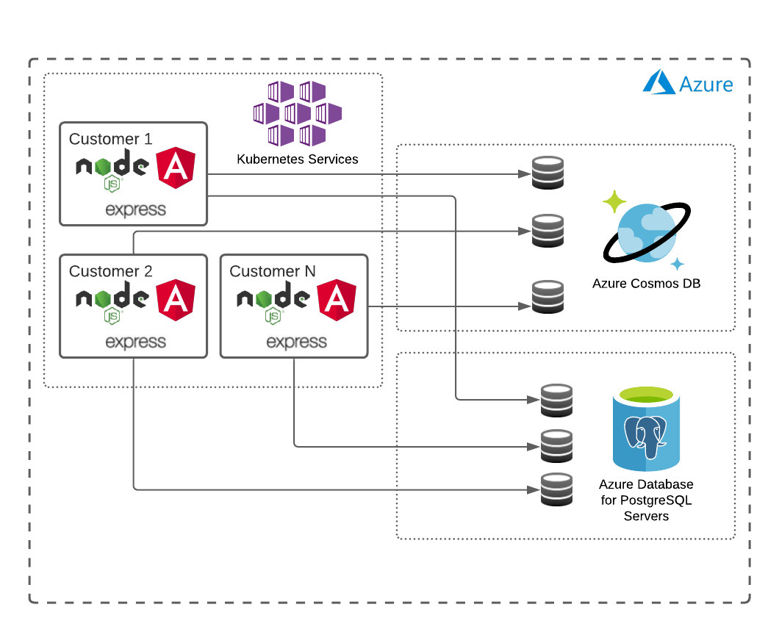
To-be
Future architecture
Notes:
Service Fabric / Service Fabric Mesh
App Services / Functions or other Azure PaaS resources
VMs
Azure Container Instances – Mainly targeted “burst” scaling
Azure Service Fabric is a distributed systems platform that makes it easy to package, deploy, and manage scalable and reliable microservices on Azure.
Azure Service Fabric Mesh is a fully managed service enabling developers to deploy containerized applications without managing virtual machines, storage, or networking resources.
Kubernetes is an open-source orchestration system for Docker containers. It handles scheduling onto nodes in a compute cluster and actively manages workloads to ensure that their state matches the users declared intentions.

Slide 7
To-be
Virtual machine vs. Docker
 | Docker Container | Virtual Machines (VMs)
Boot-Time | Boots in a few seconds. | It takes a few minutes for VMs to boot.
Runs on | Dockers make use of the execution engine. | VMs make use of the hypervisor.
Memory Efficiency | No space is needed to virtualize, hence less memory. | Requires entire OS to be loaded before starting the surface, so less efficient.
Isolation | Prone to adversities as no provisions for isolation systems. | Interference possibility is minimum because of the efficient isolation mechanism.
Deployment | Deploying is easy as only a single image, containerized can be used across all platforms. | Deployment is comparatively lengthy as separate instances are responsible for execution.
Performance | Limited performance | Native performance

Slide 8
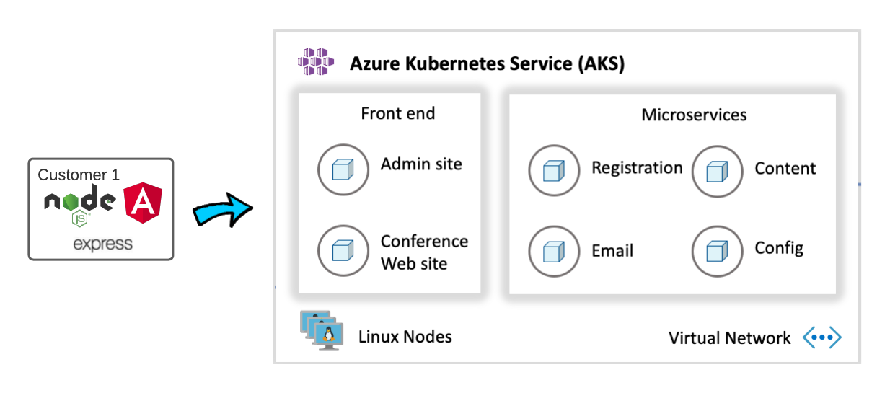
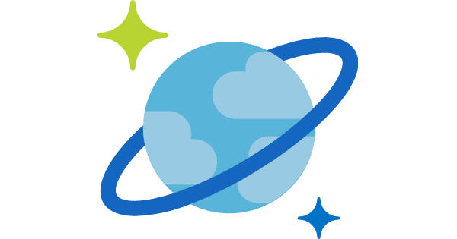
Migrate to microservice architecture
Notes:
Conference Web site: The SPA application that will use configuration settings to handle custom styles for the tenant.
Admin Web site: The SPA application that conference owners use to manage conference configuration details, manage attendee registrations, manage campaigns, and communicate with attendees.
Registration service: The API that handles all registration activities creating new conference registrations with the appropriate package selections and associated cost.
Email service: The API that handles email notifications to conference attendees during registration, or when the conference owners choose to engage the attendees through their admin site.
Config service: The API that handles conference configuration settings such as dates, locations, pricing tables, early-bird specials, countdowns, and related.
Content service: The API that handles content for the conference such as speakers, sessions, workshops, and sponsors.

Slide 9
Lab
Before hands-on lab
Get the Fabkrikam Medical source code and clone it to your own Github account.
Clone the git repository to the development build agent.
Build and upload Docker images to Azure Container Registry
Exercise 1
Migrate the existing Mongo DB data to Cosmos DB
Exercise 2
Deploy content-web and content-api to Azure Kubernetes Services (AKS).
Setup CD pipeline for automated deployment to AKS.
Exercise 3
Setup and test scaling of AKS
Setup and test scaling of Cosmos DB
Exercise 4
Improvements and fine tuning of scaling.
Run a “rolling” update of content-web
Setup routing of trafic into the AKS cluster
Notes:
Exercise 1: The provisioning of the database migration service may take some time approx. 15 minutes, so take a break and/or start on Exercise 2 (until step 12 where the CosmosDB is needed).

Slide 10
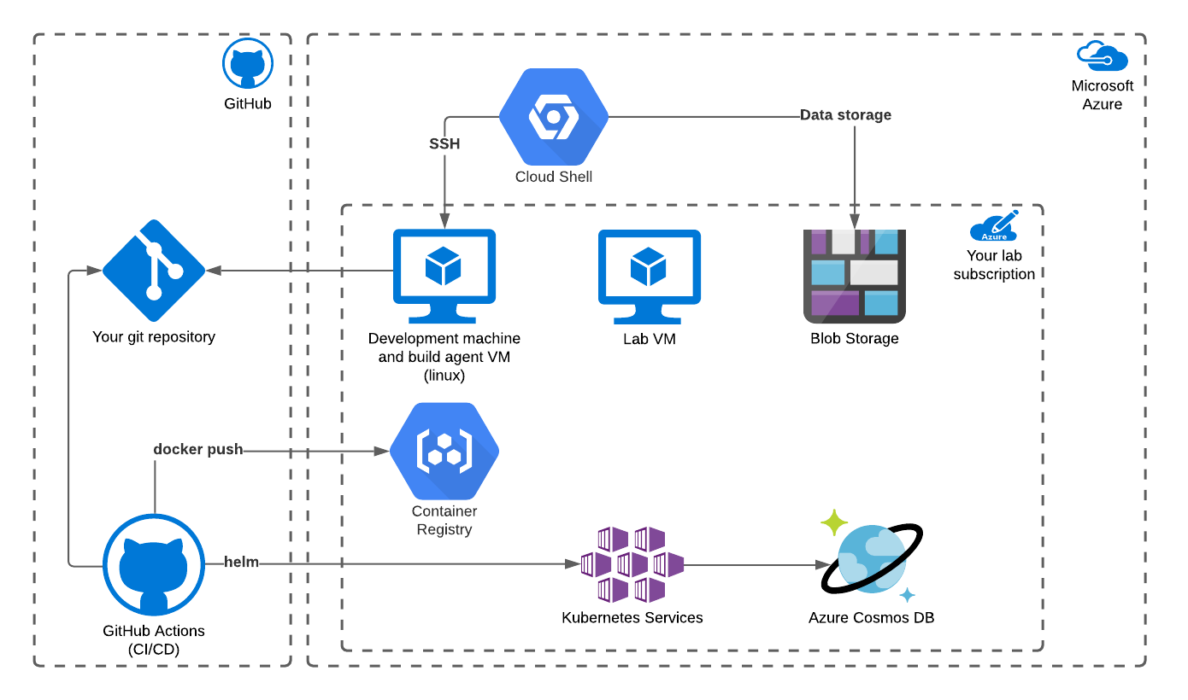
Notes:
Lab VM is the machine where the lab is executed from i.e. it’s the desktop which is shown on the left of the lab instructions.

Slide 11
Lab
Get started
Sign-up link https://bit.ly/3mmsQeM
Activation code ACTIVATE24498
Launch lab
Follow lab instructions
Tips
Open Cloud Shell (https://shell.azure.com) in your local browser.
Take it easy. Learn and understand.
The Environment Details tab in the lab contains valuable variables and references.
Notes:
Ctrl + Shift + V er paste i Cloud Shell
Et alternativ til vim på byg agenten er nano (Exit er Ctrl + X. Efter tryk på Y for save tryk på Enter)
Et alternativ til vi i Cloud Shell er code eller nano
Variable i [] står under Environment Details tab’en

Slide 12

Lab
Help
Write on Teams
We will try to help as quickly as possible.
Problems with yaml formatting: http://yamllint.com
Technical issues with the lab
Teams: https://cloudlabs.ai/ms-support

Slide 13
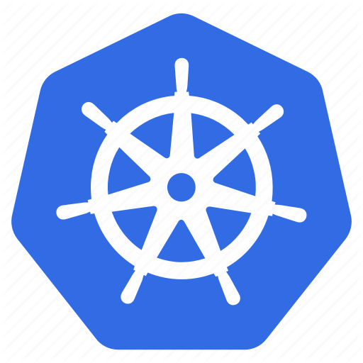

Lab
Kubernetes command-line tool (kubectl)
Kubernetes cheat sheet
https://kubernetes.io/docs/reference/kubectl/cheatsheet/
Useful kubectl commands
Scale: kubectl scale --replicas=3 deployment/api
List replica sets: kubectl get rs
List deployments: kubectl get deployments
Edit deployment: kubctl edit deployment api
List services: kubectl get services
List pods: kubectl get pods
Delete pod: kubectl pod <pod name>
Apply changes to a resource: kubectl apply -f <yaml file path>
Specify non default namespace using –n: -n ingress-demo

